Slide 1

WEB TECHNOLOGIES – LECTURE 17
UNIVERSITÀ DEGLI STUDI DI NAPOLI FEDERICO II
FRONTEND TOOLING
Luigi Libero Lucio Starace, PhD
luigiliberolucio.starace@unina.it https://luistar.github.io https://www.docenti.unina.it/luigiliberolucio.starace

Slide 2

THE ROAD SO FAR
We started our journey with foundational technologies: HTML, CSS, JS.
We built static web pages
We moved to server-side
programming
Still, the web pages we dynamically built were simple
A single stylesheet
Very little (if any) client-side JS
No external libraries/modules

Slide 3

THE ROAD AHEAD
Modern frontends can be much more complex!
Client-side JavaScript code is becoming increasingly complex
Many libraries/modules are used
Transpiling, Downleveling code
Optimizing served files
Often, stylesheet pre-/post- processors such as SASS are used
Tooling is required to support devs and automate these steps!

Slide 4

FRONTEND TOOLING
Today, we will go over the main challenges and tools to develop complex modern frontends
Agenda:
CSS Pre-/Post-processors
SASS
CSS Frameworks
Bundling and Minification
Development/Build servers

Slide 5
CSS PRE-/POST-PROCESSORS

Slide 6
CSS PRE-/POST-PROCESSORS
CSS on its own can be fun, but stylesheets soon get large, complex, and hard to maintain.
CSS Pre-/Post-Processing tools are essential in modern web development, and allow devs to efficiently creating robust, scalable, optimized stylesheets.
CSS
Pre-Processor
CSS
Post-Processor
Browser
CSS
CSS
Source Files

Slide 7
CSS PRE-PROCESSORS
Preprocessor-specific files
CSS Pre-processors are special «compilers» that can generate CSS code starting from files written in their own specific syntax
Pre-processor-specific syntax can be seen as an extesion of base CSS, introducing new features (e.g.: variables) to help write maintable stylesheets more efficiently
Widely-used CSS processors include: Sass, LESS, Stylus…
CSS
Pre-processor
CSS
Browser

Slide 8
CSS POST-PROCESSORS
Existing Stylesheets
Post-processors can automatically process and transform
existing stylesheets, typically used for:
Downleveling (see https://preset-env.cssdb.org/)
CSS
body {
color: oklch(61% 0.2 29);
}
body {
color: rgb(225, 65, 52);
}
CSS
Post-processor
Autoprefixing (see https://autoprefixer.github.io/)
.example {
transition: all .5s;
}
.example {
-webkit-transition: all .5s;
-o-transition: all .5s; transition: all .5s;
}
CSS
Optimizations (e.g.: minification or delete unused parts)
Enforce conventions and detect errors
One of the most popular post-processors is PostCSS
Browser

Slide 9
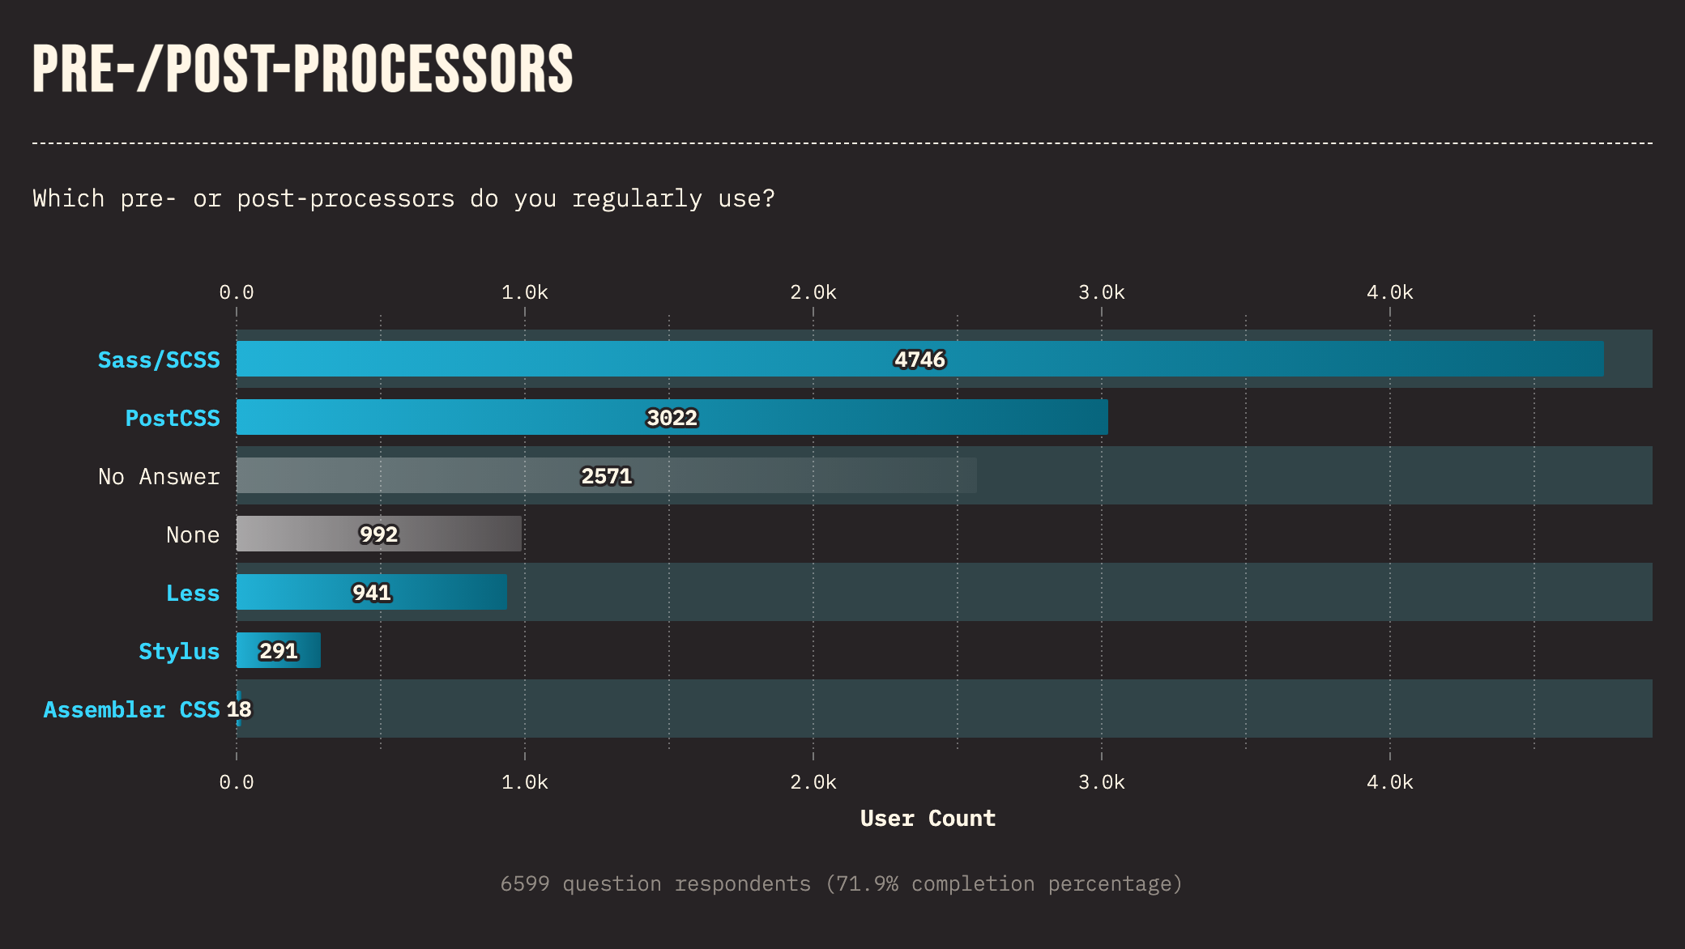
CSS PRE-/POST-PROCESSORS: ADOPTION
State of CSS Survey 2023

Slide 10

SASS
Self-defines as «CSS with superpowers»
Currently the most popular pre-processor for CSS
Been around since 2006 (that’s almost 20 years ago!)
Other preprocessors offer roughly the same features, with a slightly different syntax

Slide 11
INSTALLING SASS
Install options are documented on the official website
The easiest way to install SASS is to install it via npm
@luigi ➜ D/O/T/W/2/e/tooling $ npm install -g sass
added 17 packages in 5s
This makes the sass binary available in the system path
@luigi ➜ D/O/T/W/2/e/tooling $ sass --help Compile Sass to CSS.
Usage: sass <input.scss> [output.css]
sass <input.scss>:<output.css> <input/>:<output/> <dir/>

Slide 12
SASS: TWO SYNTAXES
Sass supports two different syntaxes: SCSS and the Indented Syntax
SCSS Syntax
Uses the .scss file extension
It’s a superset of CSS
Most popular syntax
Indented Syntax
Uses the .sass file extension
Indentation-based, like Python
Was the original syntax
$font-stack: Helvetica, sans-serif;
$primary-color: #333;
body {
font: 100% $font-stack; color: $primary-color;
}
$font-stack: Helvetica, sans-serif
$primary-color: #333
body
font: 100% $font-stack; color: $primary-color;

Slide 13
SASS: VARIABLES
Sass supports variables
They are ways to re-use values throughout our spreadsheets
When we compile a Sass file, variables are substituted by their value
$font-stack: Helvetica, sans-serif;
$primary-color: #333;
body {
font: $font-stack;
color: $primary-color;
}
body {
font: Helvetica, sans-serif;
color: #333;
}
@luigi ➜ D/O/T/W/2/e/tooling/sass $ sass file.scss file.css

Slide 14
SASS: NESTING
In HTML, we have a clear nested element hierarchy
In plain CSS, we cannot have nested rules
Sass introduces support for nesting. It can make code more readable
Too much nesting is a bad practice though! Leads to over-specific CSS!
.elem {
color: red; span {
color: blue; a {
color: green; //applies to <a>s contained
}
}
.elem { color: red;
}
.elem span {
color: blue;
}
.elem span a { color: green;
}
in <span>s contained in .elem
}

Slide 15
SASS: NESTING
/* nesting.scss |  | */ |  |  | /* nesting.css */
nav { ul { margin: 0; padding: 0; list-style: } li { display: |  | none; inline-block; | } |  | nav ul { margin: 0; padding: 0; list-style: none; } nav li { display: inline-block; }
 | a { display: block; |  |  |  | nav a {
} | padding: 6px 12px; text-decoration: none; } |  |  |  | display: block; padding: 6px 12px; text-decoration: none; }

Slide 16
SASS: MIXINS
Mixins are a way to re-use a group of CSS/Sass declarations
Can be declared using the at-rule @mixin followed by an identifier
Can then be included using the @include rule
@mixin clear-list { list-style-type: none; padding: 0; margin: 0; li {
display: inline-block;
}
}
nav ul {
background-color: aliceblue; @include clear-list;
}
nav ul {
background-color: aliceblue; list-style-type: none; padding: 0;
margin: 0;
}
nav ul li {
display: inline-block;
}
16

Slide 17
SASS: MIXINS
Mixins can also optionally include one or more parameters
@mixin theme($color: DarkBlue) { background: $color;
color: #fff;
}
.info {
@include theme;
}
.danger {
@include theme($color: DarkRed);
}
.info {
background: DarkBlue; color: #fff;
}
.danger {
background: DarkRed; color: #fff;
}

Slide 18
SASS: MODULES
/* base.scss */
$font-stack: Helvetica, sans-serif;
$primary-color: #333;
body {
font: $font-stack;
color: $primary-color;
}
/* example.css */
body {
font: Helvetica, sans-serif; color: #333;
}
.inverse {
background-color: #333; color: white;
}
/* example.scss */
@use 'base';
.inverse {
background: base.$primary-color; color: white;
}

Slide 19
SASS: PARTIALS
Sass files starting with an underscore are called partials
These files are meant to only be included by other files
Sass will not generate a stand-alone CSS files for partials
A Sass file including all variables could be a good example of a partial
/* _variables.scss */
$primary-color: purple;
$accent-color: orange;
$background-color: beige;

Slide 20
SASS: LISTS AND MAPS
Lists are sequences of values separated by commas, spaces, or slashes as long as it is consistent across the list.
Maps are sequences of key-value pairs.
Each pair has the form <key>:<value>.
Keys must be unique within a map.
$list: (120px, 240px, 480px, 800px);
$map: ("xs": 480px, "md": 768px, "lg": 1024px);

Slide 21
SASS: CONTROL FLOW RULES
Sass provides rules to control whether styles get emitted, or to emit them multiple times with small variations
Think of it as a template engine for generating CSS files!
Same idea as control flow constructs in template engines
@if/@else can be used to conditionally emit styles
@each can be used to iterate over all elements in a list/map
@for and @while have the usual semantics

Slide 22
SASS: @IF/@ELSE
@use "sass:math";
@mixin avatar($size, $circle: false) { width: $size;
height: $size;
@if $circle {
border-radius: math.div($size, 2);
}
}
.square-av {
@include avatar(100px, $circle: false);
}
.circle-av {
@include avatar(100px, $circle: true);
}
.square-av { width: 100px; height: 100px;
}
.circle-av { width: 100px; height: 100px;
border-radius: 50px;
}

Slide 23
SASS: @EACH
$sizes: ("xs": 480px, "md": 768px, "lg": 1024px); @each $sizeName, $sizeMaxWidth in $sizes { @media screen and (max-width: $sizeMaxWidth) { .hidden-#{$sizeName} {
display: none; } } } | @media screen and (max-width: 480px) { .hidden-xs { display: none; } } @media screen and (max-width: 768px) { .hidden-md { display: none; } } /*.hidden-lg omitted for the sake of brevity*/

Slide 24
CSS FRAMEWORKS
Well, these are not really «Frameworks» as in «Software Frameworks»

Slide 25
CSS FRAMEWORKS
Also when writing CSS code for our front-end, we might find ourselves solving the same problems over and over again
Create a layout system
Create a consistent typography
Style our tables, list, UI-components
Reset user agent styles to get a consistent appearence on any browser
Luckily, there is no need to start from scrach every time!
Many CSS frameworks exist, providing a set of general-purpose styles
We can use the provided styles as-is, or we can do some fine-tuning on top!

Slide 26

CSS FRAMEWORKS
Widely-used CSS frameworks include:
Bootstrap (the most popular framework, originally from Twitter)
Tailwind (known for its utility-first
approach)
Materialize, Foundation, Bulma, PureCSS, …

Slide 27
USING CSS FRAMEWORKS
Frameworks are a set of one or more CSS files
We just need to import these CSS files in our pages, and use the classes provided by the framework (as described in the docs)
We can download the CSS files and serve them from our own server
Or we can use CDNs (Content Delivery Networks) that host the CSS files for us.
Quick and convenient for prototyping, but raises some privacy concerns…

Slide 28


BOOTSTRAP EXAMPLE
Let’s look at a page featuring Bootstrap 5.3
Live demo time!

Slide 29
CUSTOMIZING CSS FRAMEWORKS
We might not want our website to look the same as a number of other websites built using the same framework.
The pre-defined styles in the framework might not meet our needs for some particular aspects
Most CSS frameworks are built using Sass or a similar tool. One way to customize a CSS framework is to change the build variables (e.g.: colors, fonts, sizes, etc…) according to our need, and then build the framework again.
Another approach is to define custom CSS styles that override some of the framework’s styles.

Slide 30
CUSTOMIZING BOOTSTRAP WITH SASS
We can import the main bootstrap Sass file (or only some of its
modules such as the grid system, the typography, etc…), and override
some variables
After compiling with Sass, we will get our own, custom Bootstrap flavor
//overriding Bootstrap variables
$primary:
$secondary:
#00647a;
rgb(254, 203, 110);
@import "../node_modules/bootstrap/scss/bootstrap.scss";

Slide 31


BOOTSTRAP EXAMPLE
Let’s compile a custom version of Bootstrap
Live demo time!

Slide 32
BUNDLING AND MINIFICATION

Slide 33

BUNDLING
Bundling combines multiple css or js files into a single one
This way, browsers perform fewer HTTP requests to load a page
CSS
<!DOCTYPE html>
<html lang="en">
<head>
<title>Page</title>
<link rel="stylesheet" href="a.css">
<link rel="stylesheet" href="b.css">
<!-- other stylesheets -->
<script type="javascript" src="a.js"></script>
<script type="javascript" src="b.js"></script>
<script type="javascript" src="c.js"></script>
<!-- other scripts -->
CSS
CSS
CSS
CSS
CSS
JS
JS
JS
JS
JS
JS
JS
JS

Slide 34
BUNDLING
Bundling combines multiple css or js files into a single one
This way, browsers perform fewer HTTP requests to load a page
<!DOCTYPE html>
<html lang="en">
<head>
<title>Page</title>
<link rel="stylesheet" href="bundle.css">
<script type="javascript" src="bundle.js">
CSS
bundle.css
JS
bundle.js

Slide 35
BUNDLING
Additional HTTP requests introduce latency
Caching strategies can help on subsequent page loads
Still, including many stylesheet/scripts has an impact on the first page load
Bundling is a widely-adopted performance optimization strategy
Beware: the order in which the single files are appended in the bundle matters!

Slide 36
BUNDLING: ‘HISTORICAL’ NOTE
Before ES modules were available in browsers, there was no way of writing modular JS code for browsers
Bundlers (e.g.: tools like Webpack, Rollup, or Parcel) took care of concatenating all source modules in a way that browsers could understand

Slide 37
TREE SHAKING
Bundlers often perform also Tree Shaking (i.e., dead code elimination)
We often need only some of the functionality of the modules we import
Modules can be quite large. Including an entire large module in the JavaScript code we distribute with our web pages, when we only use one of its functions, is ineffecient.
Tree Shaking analyzes imports and export to prune out all unused code from the final bundle
This can have a significant impact on bundle size (and thus on page load performance)!

Slide 38
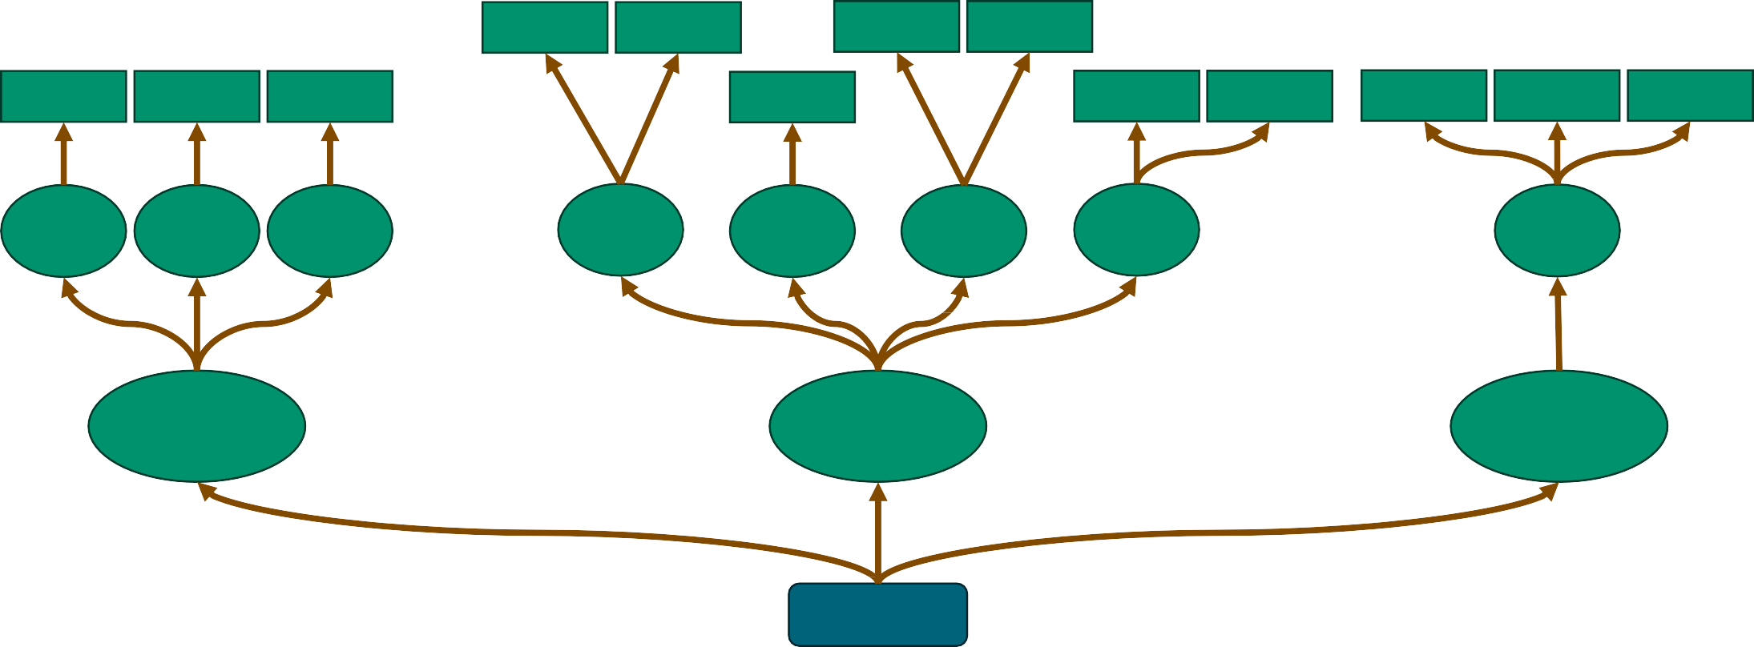
TREE SHAKING
function
function
function
function
function | function | function |  | function |  | function | function | function | function | function
File | File | File | File | File | File | File |  |  | File
1 | 2 | 3 | 4 | 5 | 6 | 7 |  |  | 8
Module A
Module B
Module C
index.js

Slide 39
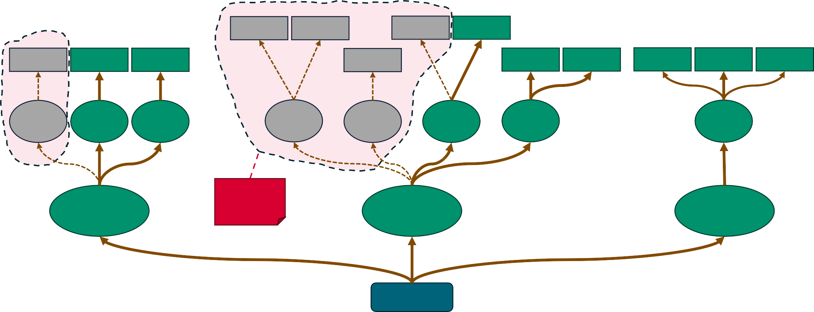
TREE SHAKING
function
function
function
function
function | function | function |  | function |  | function | function | function | function | function
File | File | File | File | File | File | File |  |  | File
1 | 2 | 3 | 4 | 5 | 6 | 7 |  |  | 8
Unused code
Module A
Module B
Module C
index.js

Slide 40
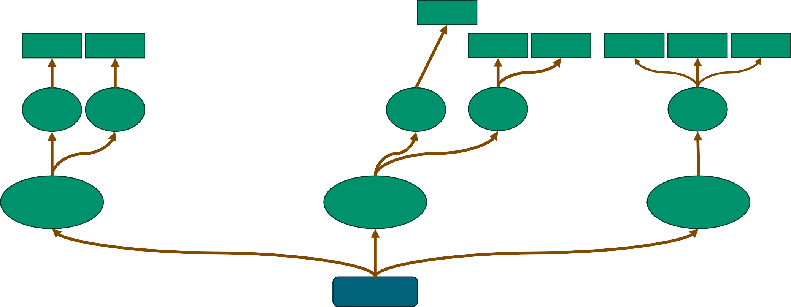
TREE SHAKING
 |  | function
function | function |  | function | function | function | function function
File | File | File | File |  |  | File
2 | 3 | 6 | 7 |  |  | 8
Module A
Module B
Module C
index.js

Slide 41

MINIFICATION
When humans write code, indentation and proper variable names are crucial
readability, understandability, maintainability…
Browsers don’t really need readable code
We could optimize file transfer by removing
«unnecessary» whitespaces and shortening our source code without impacting its functionality
This process is called minification, and the resulting compressed files are referred to as minified
A Steamroller «minifying» code.
Image generated by DALL-E 3

Slide 42
MINIFICATION: EXAMPLE
let msg = "Hello";
let name = "Web Technologies"; let str = `${msg}, ${name}!`; let b = true;
if(b === true) document.getElementById('msg').innerHTML = str;
188 Bytes
let msg="Hello",name="Web Technologies",str=`${msg},${name}!`,b=!0;!0===b&& (document.getElementById("msg").innerHTML=str);
123 Bytes
34,57% compression
Saved 65 Bytes

Slide 43
MINIFICATION: EXAMPLES
The effects of minification are greater the larger the source files
React 18.2.0 weights ~85kB
The minified React library weights ~25kB
Compression rate: ~70%, saving ~60kB in file transfer size
Moment.js 2.29.4 weights ~151kB
The minified version weights ~75kB
Compression rate: ~50%, saving ~76kB in file transfer size

Slide 44
DEVELOPMENT AND BUILD WITH VITE

Slide 45

VITE
Pronounced /vit/ (like «veet»)
A tool to support web developers in developing and deploying their projects
Two key components:
A development server with a number of advanced features to streamline development
A build tool to create highly optimized static assets, ready for production

Slide 46
CREATING A VITE PROJECT
@luigi ➜ D/O/T/W/2/e/tooling/vite $ npm create vite@latest
√ Project name: ... hello-vite
√ Select a framework: » Vanilla
√ Select a variant: » TypeScript
Scaffolding project in D/O/T/W/2/e/tooling/vite...
Done. Now run: cd hello-vite
npm install
npm run dev
@luigi ➜ D/O/T/W/2/e/tooling/vite $ npm create vite@latest
√ Project name: ... hello-vite
? Select a framework: » - Use arrow-keys. Return to submit.
> Vanilla Vue React Preact Lit Svelte Solid Qwik Others
@luigi ➜ D/O/T/W/2/e/tooling/vite $ npm create vite@latest
√ Project name: ... hello-vite
√ Select a framework: » Vanilla
? Select a variant: » - Use arrow-keys. Return to submit.
> TypeScript
JavaScript

Slide 47
LET’S TAKE A LOOK AT THE SCAFFOLDING
dev starts the dev server.
Vite watches for changes to the source files, and automatically reloads the web app when necessary (live reload).
build generates an optimized bundle, ready for production
preview is a simple static server, serving the files generated during the build phase.
{
"name": "hello-vite", "private": true, "version": "0.0.0",
"type": "module", "scripts": {
"dev": "vite",
"build": "tsc && vite build", "preview": "vite preview"
},
"devDependencies": {
"typescript": "^5.2.2",
"vite": "^5.0.8"
}
}

Slide 48

LET’S TAKE A LOOK AT THE SCAFFOLDING
Let’s take a look at the rest of the scaffolding code
Live demo time!
Will the lecturer be able to actually start the dev server, make a meaningful improvement to the web app, and build the whole app again?

Slide 49
STARTING THE DEV SERVER
@luigi ➜ D/O/T/W/2/e/tooling/vite $ cd .\hello-vite\
@luigi ➜ D/O/T/W/2/e/t/v/hello-vite $ npm install
added 10 packages, and audited 11 packages in 10s @luigi ➜ D/O/T/W/2/e/t/v/hello-vite $ npm run dev
hello-vite@0.0.0 dev
vite
VITE v5.0.10 ready in 781 ms
Local: http://localhost:5173/
Network: use --host to expose
press h + enter to show help

Slide 50
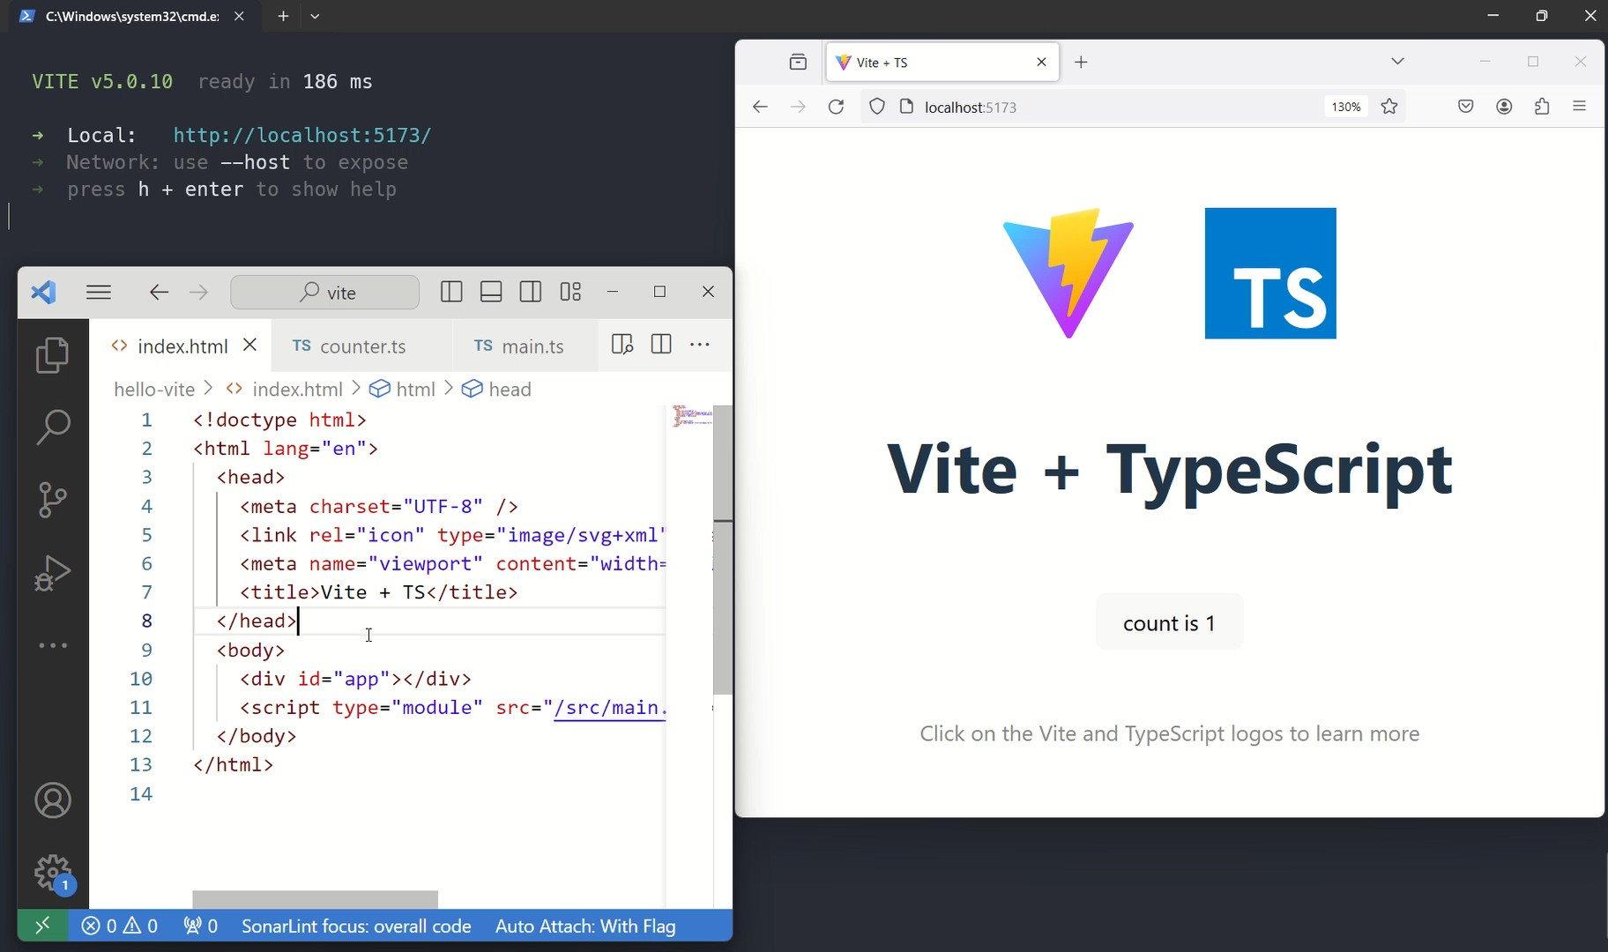
STARTING THE DEV SERVER

Slide 51
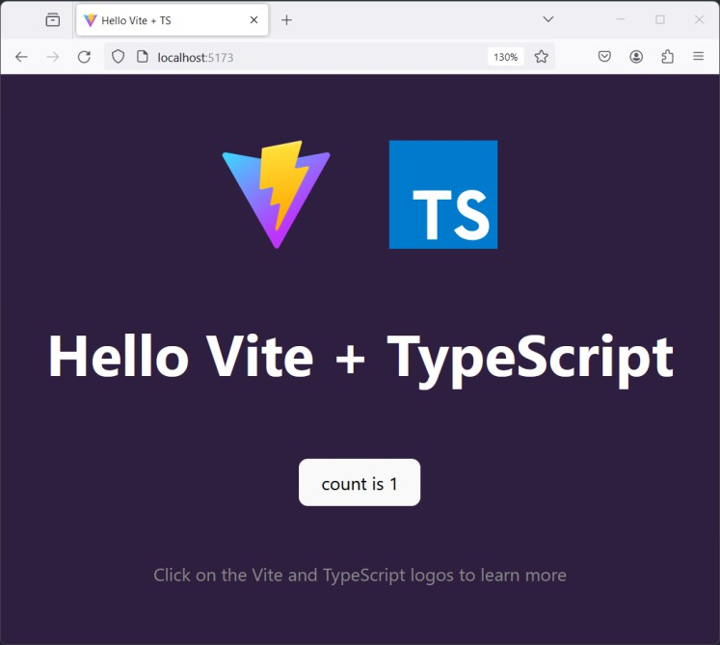
ADDING SASS TO THE MIX
Suppose we want to include an additional Sass stylesheet
First, we need to install sass in this project dev dependencies
> npm install –D sass
Then, we create a sass stylesheet file
We let Vite know that that file needs to be included in the app
We can do that by importing it our main.ts file
Vite automatically will detect a Sass file, compile it using sass, and bundle it after the original CSS file.

Slide 52
BUILDING OUR PROJECT
@luigi ➜ D/O/T/W/2/e/t/v/hello-vite $ npm run build
hello-vite@0.0.0 build
tsc && vite build
vite v5.0.10 building for production...
8 modules transformed.
dist/index.html | 0.46 | kB | │ | gzip: | 0.29 | kB
dist/assets/index-v5kLGx6_.css | 1.21 | kB | │ | gzip: | 0.63 | kB
dist/assets/index-DiAK_ebR.js | 3.05 | kB | │ | gzip: | 1.62 | kB
built in 173ms

Slide 53
BUILDING OUR PROJECT
During the build phase, Vite did quite a lot of work for us
Analyzed what are the static resources we actually use in our app
Compiled Sass (resp. TypeScript) files to CSS (resp. JavaScript) files
Bundled Sass and CSS files in a single file
Bundled JavaScript files in a single file
Minified the bundle files
Performed filename fingerprinting on the final bundles
Moved all resources to the /dist directory, and updated the
index.html file with correct imports for the bundles

Slide 54
FILENAME FINGERPRINTING
The final bundles produced by Vite have a peculiar name:
index-v5kLGx6_.css, index-DiAK_ebR.js
The last part of the filename is an hash of their current contents
This way, when we build a new version of the app, with some changes to the css or js files, the filename will change
This techniques can be used to avoid cache staleness issues
Suppose the files were called simply index.css and index.js
A browser visits our page one minute before we roll out a new version
That browser might keep using the old index.css and index.js files it stored in its cache for some time

Slide 55
REFERENCES
Client-side Tooling Overview
MDN web docs
https://developer.mozilla.org/en-US/docs/Learn/Tools_and_testing/Understanding_client-side_tools/Overview
Sass: Guide
https://sass-lang.com/guide/
Bootstrap: Getting Started
https://getbootstrap.com/docs/5.3/getting-started/introduction/
Get started with Tailwind CSS
https://tailwindcss.com/docs/installation
Vite: Official Guide
https://vitejs.dev/guide/

